Slide 1
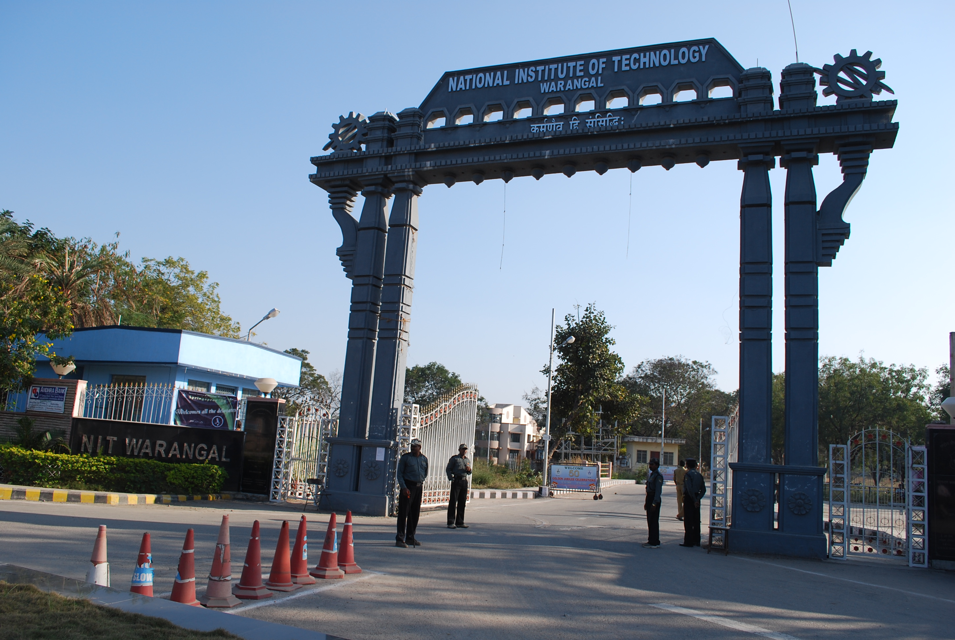
Welcome
To
NITW

Slide 2

Department engaged in research activity
• MATHEMATICS
• PHYSICS
• CHEMISTRY
• SCHOOL OF
MANAGEMENT
• HUMANITIES & SOCIAL
SCIENCES
• PHYSICAL EDUCATION
• CIVIL ENGINEERING
• ELECTRICAL ENGINEERING
• MECHANICAL ENGINEERING
• ELECTRONICS & COMM. ENGG
• METALLURGICAL & MATERIALS ENGG
• CHEMICAL ENGINEERING
• COMPUTER SCIENCE & ENGINEERING
• BIOTECHNOLOGY

Slide 3

Faculty Details[ Based on NIRF]
Total No. of Faculty members - 238
No of PhD Faculty members - 238
No of Women Faculty members- 56

Slide 4

NITW-Past-recruiters

Slide 5
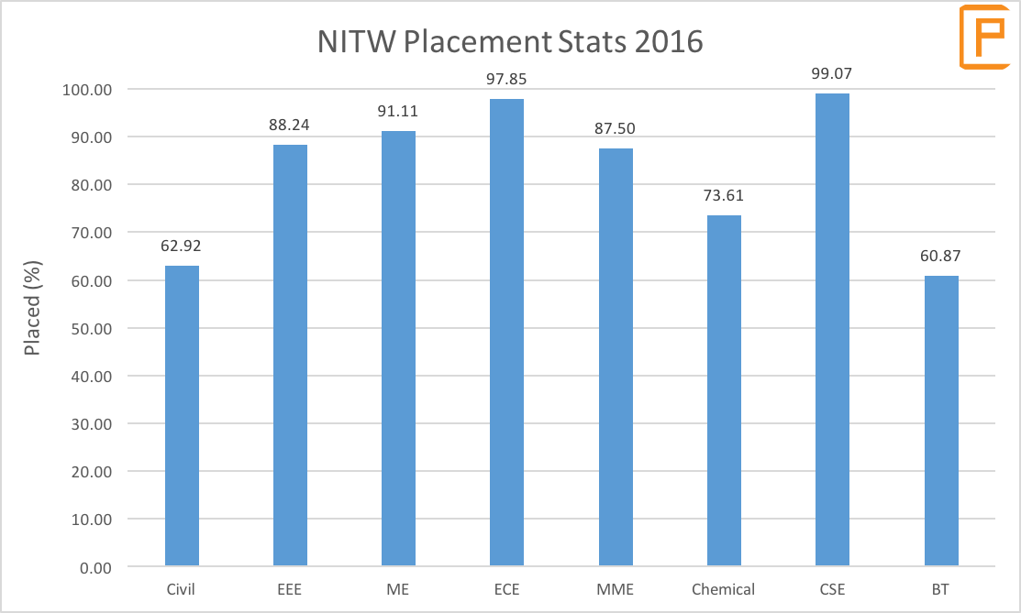


Slide 6
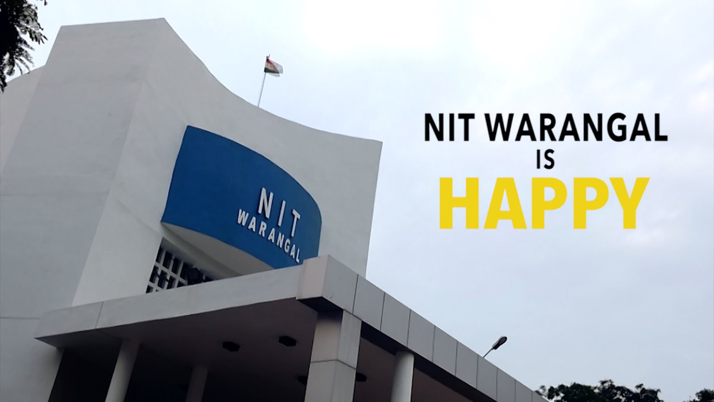
NIRF(2018)
NIT Ranking 4
Overal ranking-28
Engineering (Research and Teaching)

Slide 7
WHY MCA @ NITW ?
MCA students in our college get the full 'CSE' experience. The faculty is the same as that of Computer Science students (UG and PG).
when you are sitting for placements. MCA students are eligible for the top notch tech companies that come for recruitment.
MCA students are also given equal opportunity when it comes to extra curriculum participation. May it be hackathons, college fests, etc. everyone can have rich experience of what the college has to offer.

Slide 8
National Institute of Technology (NIT Warangal)
Address : National Institute of Technology, Warangal 506004, TS, INDIA , Telangana
Country : India
Established : 1959
Website : http://www.nitw.ac.in
E-mail : director@nitw.ac.in
Phone : +91-870-2462000

Slide 9
A flex for department information
1.Department research and consistency profile.
2.Department P.G. programs.
3.Department U.G. programs.
4.MCA @ NITW
5.MCA profile(high profile person in mca alumini)

